Slide 1

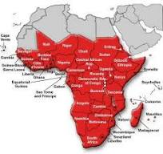

Logistics and Innovation Education as Pathways to Lifelong Careers, Economic Growth, and Africa’s Sustainable Development.
by
Prof. O.T. Ebiringa
Director Career Services and Counselling Centre
Pioneer Dean, School of Logistics and Innovation Technology,
Former Dean School of Management Technology, Federal University of Technology, Owerri.
The maiden School of Logistics and Innovation Technology Lecture Series, held on September 2, 2025 @ SLIT Lecture Auditorium, Federal University of Technology, Owerri

Slide 2
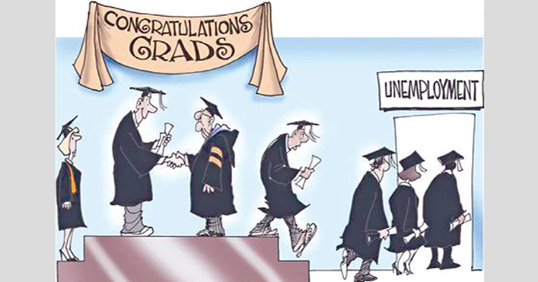


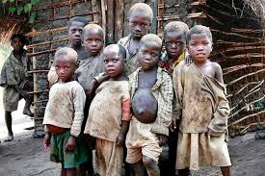
Introduction
Theme: ‘Smart Frontiers in Logistics and Innovation: Redefining Africa’s Path to Sustainable Development’ is timely given the of the near lack of lifelong careers, and growing without developing, leading to abject poverty, despondency and lack of livability of human inhabitants. Poor logistics and innovation practices especially at public governance levels seem a key casual factor of these unfortunate state of affirms in most African communities.

Slide 3

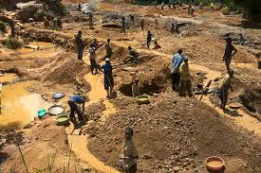
Africa: A Blessed Geographical Region
Home to more than 1,246,000,000 people.
Oil and gas: Nigeria, Angola, Gabon, Sudan are major producers.
Gold: Botswana, DRC, Nigeria and Ghana have large deposits.
Diamonds: Botswana, DRC.
Copper, Cobalt : The DRC.
Manganese: Gabon.
Iron ore: Angola, Nigeria.
Bauxite: Guinea, Mali.
Phosphate: Senegal.
Uranium: (Chad, Mali, Sudan) demanded for nuclear reactors and energy.
Cobalt: DRC is the world largest producer (essential for production of electric vehicles and electronics batteries)
Lithium: DRC has the world’s largest deposit (key input to electric vehicle batteries).

Slide 4
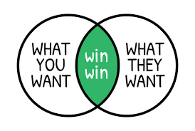

Purpose Pioneering Redefining of Logistics & Innovation Education
Applying multidisciplinary knowledge to drive Lifelong careers, productivity, value creation, income generation, economic growth, livability and sustainable development

Slide 5
Background to Redefining Logistics + Innovation Education in Africa
FUTO is pioneering the redefinition of Logistics and Innovation Education in Africa.
Face with lifelong careers existential threat following the delisting of SMAT programmes the by Federal Government (2017).
The intervening event of COVID-19 pandemic amplified relevance of logistics & innovation to growth and sustainable development globally’
As Faculties, we took our destiny in our hands, worn our intellectual reengineering thinking caps → SLIT creation.
Current impact at FUTO:
4 NUC accredited programmes
1 resource verified, 1 awaiting verification
2000+ students enrolled

Slide 6

We Lost A Distinguished Colleague in this Joinery
Late Engr. Dr. Charles Nnamdi Ononuju

Slide 7
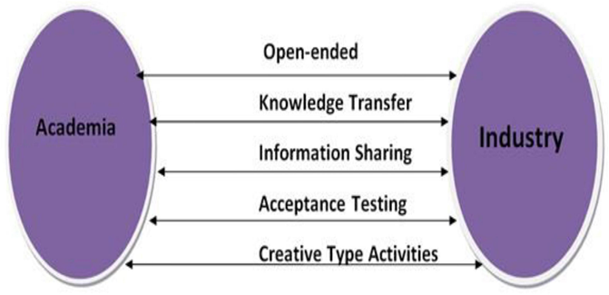

Evaluation of Traditional Logistics Education
Shortcomings:
Conceptually Narrow & siloed in transport ecosystem
Lack multidisciplinary
Weak curricula & career pathways
Skills mainly learnt on the job
Need for integration: Technology, Systems, Entrepreneurship, Management (TSEM)

Slide 8

Lecture Objective
Raise awareness & foster industry–academia partnerships and collaborations for quality and impactful diversified logistics and innovation education in Africa;
Formulating strategies for promoting sustainable implementation of redefined logistics and innovation education for attainment of lifelong careers, high economic growth rate and sustainable development in Africa, starting from FUTO Nigeria.

Slide 9

Why This Conversation Matters
Graduate unemployment vs. employer skill shortages
Africa’s challenges: unemployment, inequality, climate change, urbanization, tech disruption
Logistics & innovation = strategic education imperative

Slide 10

Understanding Logistics in the 21st Century
Beyond transporting/trucking/warehousing → Managing complex systems and processes
Applications: healthcare, elections, education, manufacturing, Public Governance, events management, military, disaster response
Logistics = “Central Nervous System of Society”

Slide 11

Innovation Education
Complements logistics by reinventing systems
Fosters: adaptability, entrepreneurial thinking, lifelong learning
Careers today = fluid, not fixed

Slide 12

Bridging the Learning–Livelihood Gap
Disconnect between academia & industry
Problems: skill mismatch, unemployment, lack of entrepreneurship
Solution: Pedagogical reforms → experiential learning, internships, digital literacy

Slide 13

Logistics & Innovation as Growth Catalysts
Economic sectors impacted: agriculture, manufacturing, IT, finance, transport, oil & gas, Management services
Example:
Africa loses 40% harvest due to poor transport and Supply chain logistics
M-Pesa, Monipoint, Opay etc are African FinTechs logistics driving financial inclusion
Ethiopian Airlines, Airpeace are African Aviation logistics success stories

Slide 14

Universities as Economic Engines
Redefined logistics = system engineering + innovation + management science + entrepreneurship
Produces techno-managerial graduates
Universities = competitiveness drivers of knowledge and skills production for economic growth and sustainable development

Slide 15
Education for Sustainable Development
Green logistics: waste reduction, renewable energy, smart cities
Innovation: climate-smart agriculture, digital governance
Aligned with SDGs (4, 8, 9, 11, 13)

Slide 16

SLIT Philosophy, Mission, Vision
Philosophy: Manage system complexities through logistics & innovation
Mission: Educate students with knowledge & skills to optimize systems
Vision: Be a global leader in logistics & innovation education

Slide 17
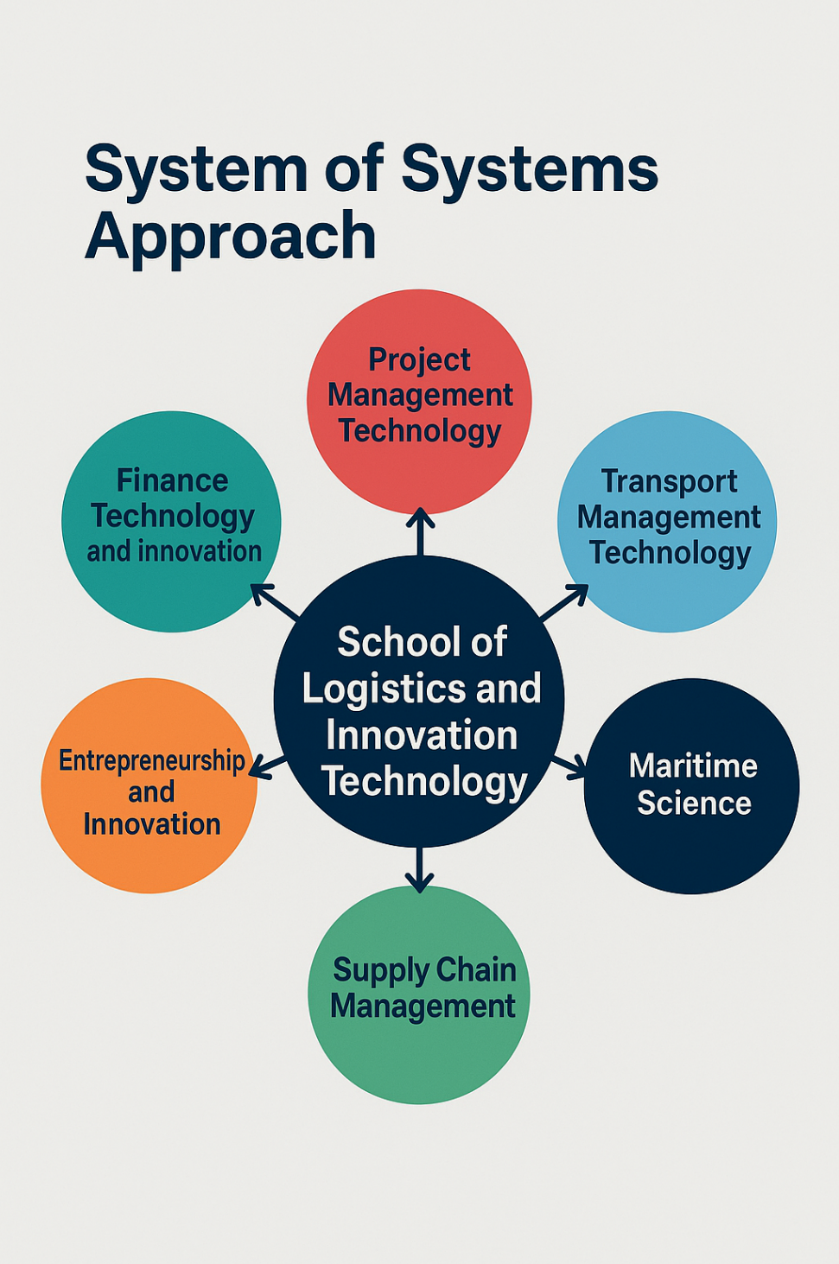
SLIT Inter-Curricula Collaboration
Departments (6):
Project Management Tech
Logistics & Transport Tech
Logistics and Supply Chain Management
Maritime Science & Tech
Entrepreneurship & Innovation
Finance Tech & Innovation
Integrated curricula, cross-department collaboration

Slide 18
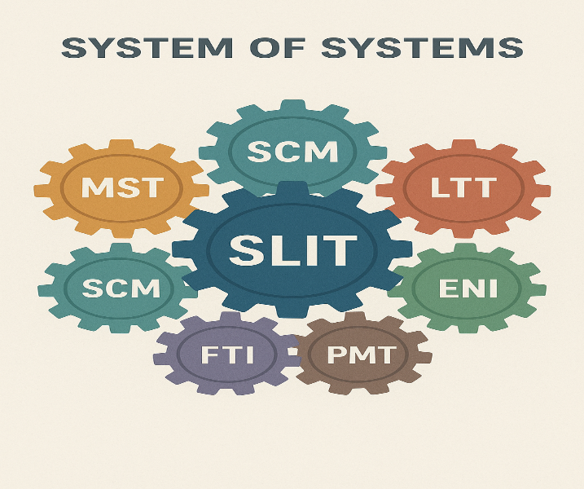

Slide 19


Lifelong Career Pathways
Diverse careers across transport, ICT, finance, maritime, manufacturing, healthcare, defense, entrepreneurship, fintech etc

Slide 20
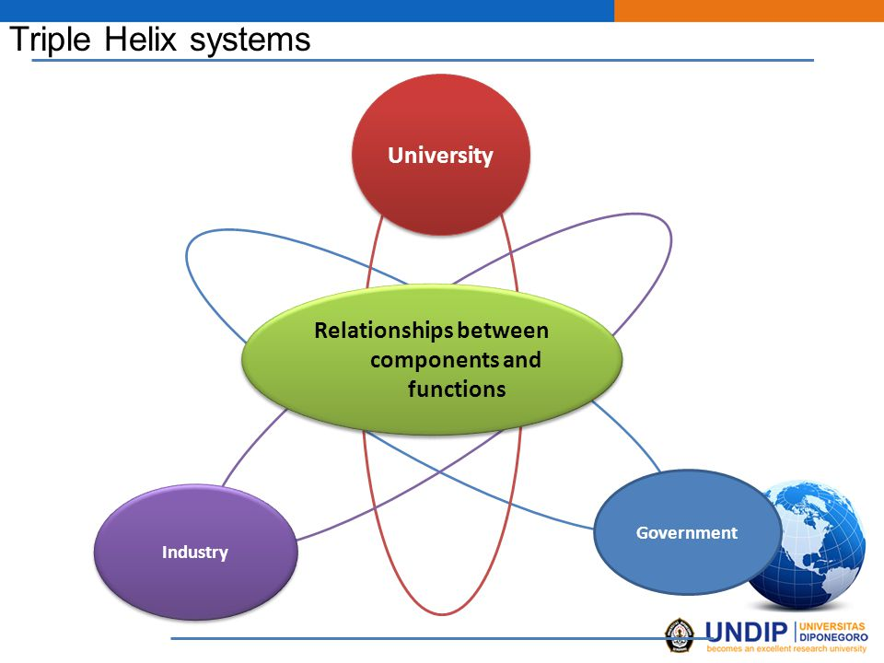
Way Forward
Strengthen education capacity
Foster lifelong learning
Drive digital integration (AI, IoT, blockchain, cyber-security)
Align with AfCFTA & sustainability goals
Expand entrepreneurship & SME support

Slide 21

Final Vision
Africa’s prosperity powered by logistics & innovation
Indigenous innovators driving sustainable development
Graduates as system managers, innovators, and nation-builders

Slide 22



Slide 23
Thank you for your attention

Slide 24
Questions, Reactions and Discussions

